Slide 1
SWE 4637: Cross-Platform Mobile Development

Slide 2
JSX
An extension to JavaScript that you will use to build your UI interfaces.
Notes:
In short…. JSX is an extension to JS.
But before we dive too deep into this...

Slide 3



Notes:
But before we dive too deep into this, let’s put some cross-platform UI design solutions into perspective.

Slide 4
Notes:
First we have iOS.

Slide 5
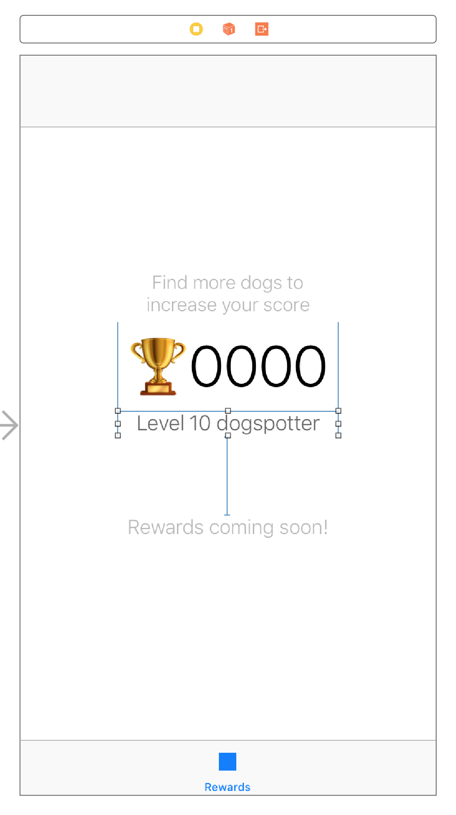
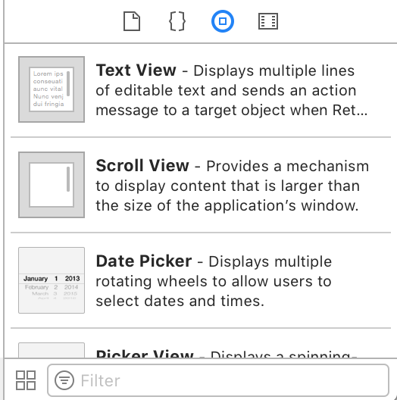
Notes:
Using Xcode we get a “drag and drop” interface.

Slide 6

Unfortunately you will have to deal with autolayout constraints
Notes:
Autolayout
There’s also a way to code things directly...

Slide 7
let textLayer = CATextLayer() textLayer.backgroundColor = color.cgColor
textLayer.foregroundColor = UIColor.white.cgColor textLayer.frame = frame textLayer.alignmentMode = kCAAlignmentLeft textLayer.isWrapped = true let font = CTFontCreateWithName("System" as CFString, 18.0, nil) textLayer.font = font textLayer.fontSize = 18.0 textLayer.contentsScale = UIScreen.main.scale textLayer.string = label self.view.layer.addSublayer(textLayer)
Notes:
And in fact, this is what Apple does internally. They build their stuff via code.
Beginners still prefer auto layout.

Slide 8
let textLayer = CATextLayer() ... self.view.layer.addSublayer(textLayer)
Notes:
Then there’s Android

Slide 9
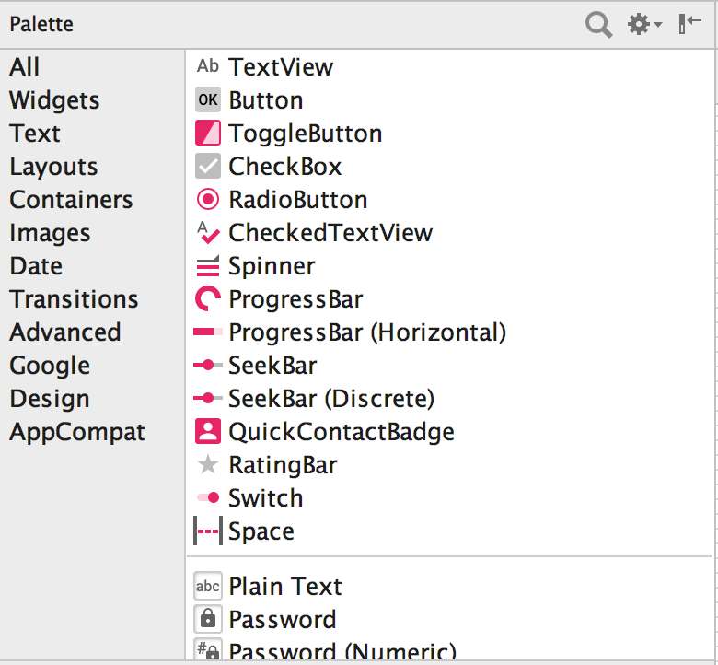
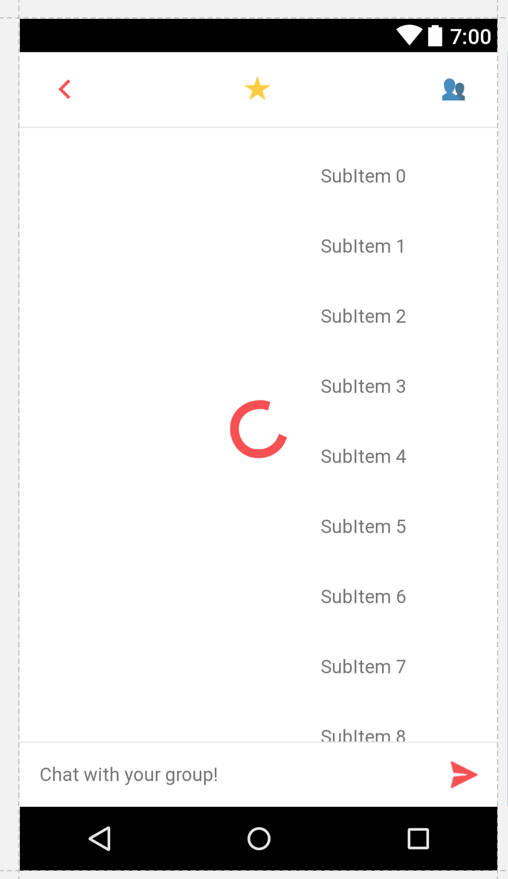
LinearLayout myLayout = findViewById(R.id.main); Button myButton = new Button(this); myButton.setLayoutParams(new LinearLayout.LayoutParams(
LinearLayout.LayoutParams.MATCH_PARENT, LinearLayout.LayoutParams.MATCH_PARENT)); myLayout.addView(myButton);
let textLayer = CATextLayer() ... self.view.layer.addSublayer(textLayer)
Notes:
Android also has a drag and drop interface.
Also supports building layouts via code.
In addition to this, however,

Slide 10
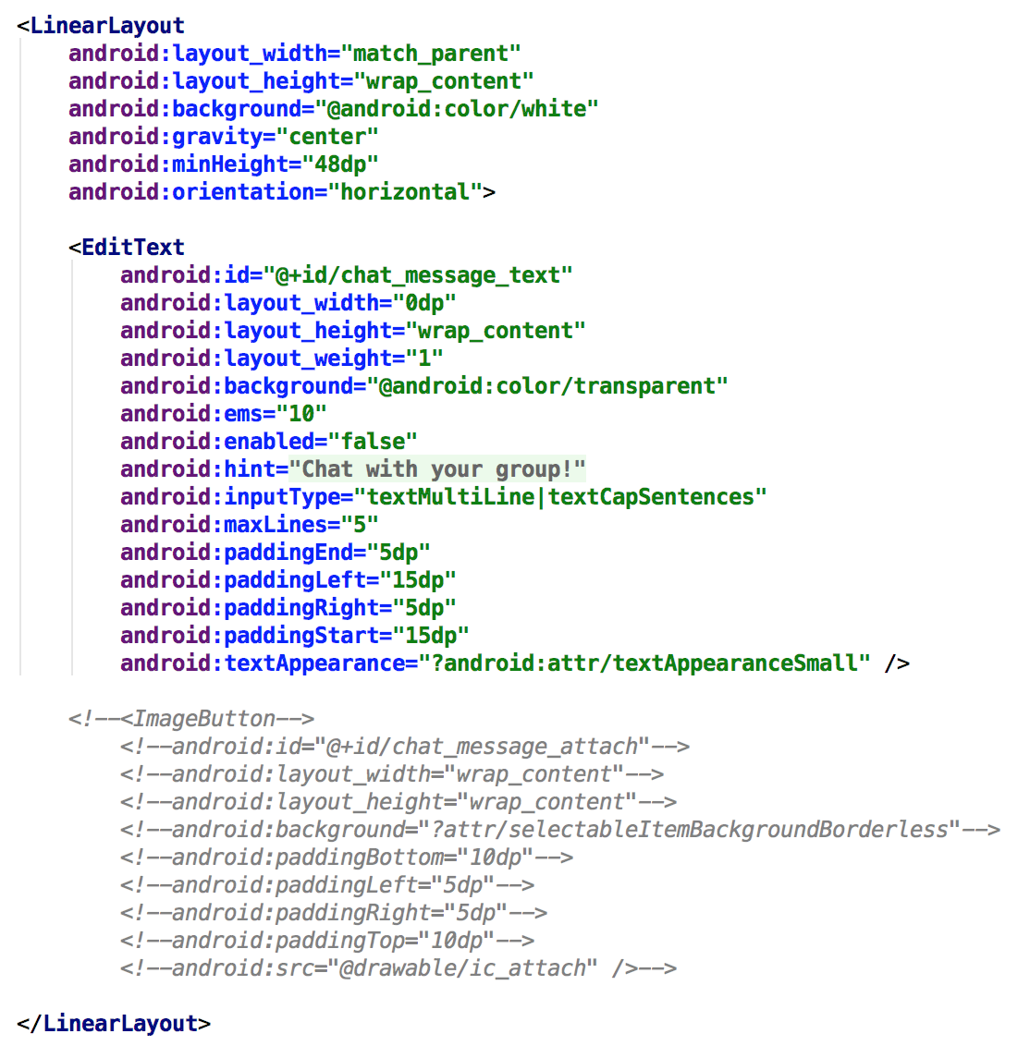
LinearLayout myLayout = findViewById(R.id.main); Button myButton = new Button(this); myButton.setLayoutParams(new LinearLayout.LayoutParams(
LinearLayout.LayoutParams.MATCH_PARENT, LinearLayout.LayoutParams.MATCH_PARENT)); myLayout.addView(myButton);
let textLayer = CATextLayer() ... self.view.layer.addSublayer(textLayer)
Notes:
In addition to this, however, Android cleanly integrates with XML.
Advanced Android developers tend to build UI using XML directly because this drag and drop interface is really bad..

Slide 11
let textLayer = CATextLayer() ... self.view.layer.addSublayer(textLayer)
Notes:
Finally, we have react native

Slide 12
How do we build layouts in React Native?
Notes:
Answer is...

Slide 13
How do we build layouts in React Native?
Programmatically (in markup style) — this means no drag and drop interface builder.
Notes:
For context let’s go through some history...

Slide 14
const ourNestedView = ( <View foo='bar'> <Text>42</Text> </View> )
Notes:
There are IDEs that offer some kind of interface building functionality, though limited. In this class we will only be using JSX to create our layouts. It’ll become second nature quickly.

Slide 15
let textLayer = CATextLayer() ... self.view.layer.addSublayer(textLayer)
const ourNestedView = ( <View foo='bar'> <Text>42</Text> </View> )
Notes:
Building a layout with JSX once and having it work on both iOS and Android is priceless.
Imagine all of the time you saved.

Slide 16
Creating a project from scratch

Slide 17
render() { return ( <View style={styles.container}> <Text>Open up App.js to start working on your app!</Text> <Text>Changes you make will automatically reload.</Text> <Text>Shake your phone to open the developer menu.</Text> </View> ); }
Notes:
This is just rendering JSX markup. What renders depends on what is returned.

Slide 18
render() { return ( <View style={styles.container}> <Text>Open up App.js to start working on your app!</Text> <Text>Changes you make will automatically reload.</Text> <Text>Shake your phone to open the developer menu.</Text> </View> ); }
const ourNestedView = ( <View foo='bar'> <Text>42</Text> </View> )
Notes:
Our nested view can just be returned directly.

Slide 19
render() { return ourNestedView; }
const ourNestedView = ( <View foo='bar'> <Text>42</Text> </View> )
Notes:
As long as ourNestedView is defined within scope.

Slide 20
render() { return ( <View style={styles.container}> <Text>Open up App.js to start working on your app!</Text> <Text>Changes you make will automatically reload.</Text> <Text>Shake your phone to open the developer menu.</Text> </View> ); }
Notes:
Now, what exactly is going on here?

Slide 21
render() { return ( <View style={styles.container}> <Text>Open up App.js to start working on your app!</Text> <Text>Changes you make will automatically reload.</Text> <Text>Shake your phone to open the developer menu.</Text> </View> ); }
React Native calls the render function every time a change occurs.
Notes:
Make change. Save file. Application is reloaded instantly.

Slide 22
render() { return ( <View style={styles.container}> <Text>Open up App.js to start working on your app!</Text> <Text>Changes you make will automatically reload.</Text> <Text>Shake your phone to open the developer menu.</Text> </View> ); }
React Native calls the render function every time a change occurs.
Sneak Peek: there’s something called the “state” of a component. It’s basically a variable that says what to render. When the values of this variable are changed, the render function is called again. You will learn more about a component’s state on week 2.
Notes:
For now, an important detail is that React Native also re-renders a component whenever its state changes.
You might’ve noticed that this reloading occurs almost instantaneously. This is...

Slide 23
Virtual DOM (Document Object Model)
A virtual representation of a desired view state
(not necessarily the same thing as the DOM on a browser)
Notes:
This is because of the fact that React Native uses a virtual DOM.

Slide 24
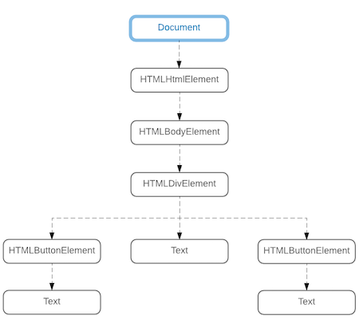
Virtual DOM (Document Object Model)
Notes:
In a browser, the virtual DOM can look something like this. It’s a representation of what is rendered and where.

Slide 25
render() { return ( <View style={styles.container}> <Text>Open up App.js to start working on your app!</Text> <Text>Changes you make will automatically reload.</Text> <Text>Shake your phone to open the developer menu.</Text> </View> ); }
React Native calls the render function every time a change occurs.
Notes:
Now where does the virtual DOM fall into place in this picture? You might be thinking that re-rendering an entire nested View component every time you make a change is really expensive and slow. What if you have 100 text components?

Slide 26
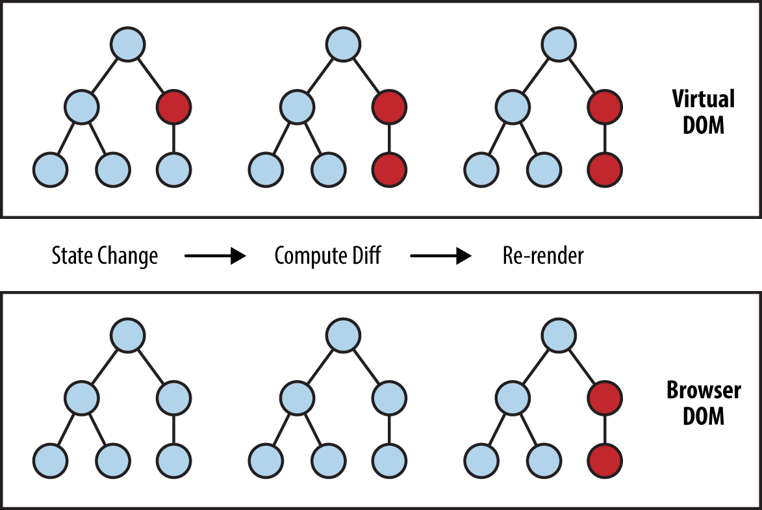
React Native
Components
Notes:
The virtual DOM computes the difference in the DOM after a state change and only re-renders the affected nodes.
Change text here
Affects related node
V DOM reports change
RN reloads only affected

Slide 27
React Native
Components
Notes:
How does this rendering step happen?
Answer is why it’s called React “Native”

Slide 28
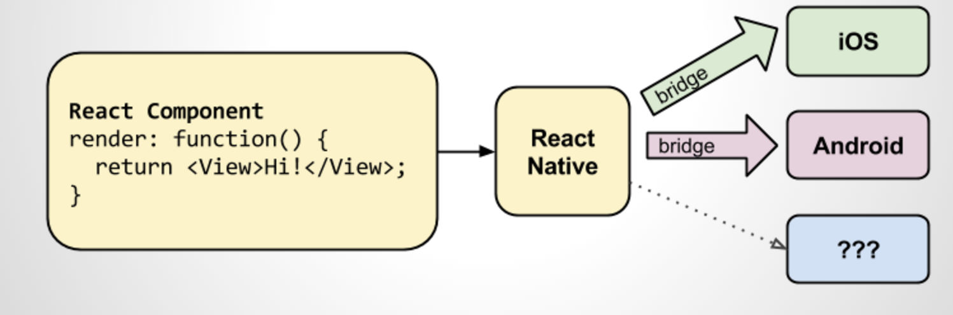
Notes:
Technically any other platform is supported as long as somebody writes that translation bridge.

Slide 29
const ourNestedView = ( <View foo='bar'> <Text>42</Text> </View> )
View
UIView
TextView
UILabel
Notes:
How does the bridge work?
If we tell RN to render a view… These platforms will never know what this JSX is. Instead, they will directly render their native components.
You might start to see the value of writing code once and having it work on both platforms automatically. Possibilities are endless.

Slide 30
const styles = StyleSheet.create({ container: { flex: 1, backgroundColor: '#fff', alignItems: 'center', justifyContent: 'center', }, });
Basically “CSS” brought to a mobile platform
https://github.com/vhpoet/react-native-styling-cheat-sheet
Notes:
We will elaborate on this a lot more, but for now… have this cheat sheet

